Slide 1


CompSci club
Libraries and Modules - 10/25/21
If you ever wanted to start building big applications, you are going to want to know about these!

Slide 2

Our person of the day!
Tony Fadell
On Saturday marked a monumental anniversary, one that perhaps no one fully understands the impact of: The 20th anniversary of the iPod
In 1997, when Steve Jobs rejoined Apple, the company was weeks away from bankruptcy
With the main catch phrase being “1000 Songs in Your Pocket,” Fadell and Steve Jobs teamed up to pitch a revolutionary idea that would change not just the way we listen to music, but set the scene for the iPhone 7 years later
2 years later after the iPod, Apple stuck again with the release of the iTunes Store, which accounts for 75% of the global music market ($6.9 billion per year)
Fadell would help work on the iPhone and its 3 generations before leaving Apple in 2008
He would find Nest Labs, which he sold to Google for $3.2 billion in 2014
Father of the iPod, Co-Creator of iPhone

Slide 3



Roadmap for Today
What are Libraries?
An introduction what libraries are, and why we think that you will really like them!
Examples of Popular Python Libraries
There are thousands of libraries for Python — we will cover just a few of them!
Practice
Some practice using the libraries you have just learned about!
Notes:
Ask what Github is and what version control is

Slide 4
Before we do an entire presentation about them, we should show how useful they are!
An introduction to
Programming Libraries

Slide 5

AN overview of Libraries
Just some technical mumbo-jumbo before we get started, the word library and module mean nearly the same thing, but there is a difference
A library is a collection of related functionality, and a module has only a single piece of functionality
So, a library is comprised of many modules
To why we use libraries, it’s important to remember programming doesn’t necessarily mean reinventing the wheel with every single program
In other words, for hard complex tasks that would take weeks to implement from scratch, a library can be a life-saver
A library is a reusable chunk of code, a group of functions and methods that someone else has written and we can run in our code as much or as little as want

Slide 6
Libraries in Python
import math
print(math.sqrt(64)) # 8.0
In order to use a library in Python, use the import word at the beginning of your program and then the name of the library
If you would like to not type out the name of the every single time, you can write import and use the word as to create an alias for the module
You can also create your own module in separate Python files, something we might cover more in-depth later in the year
If you would like to import all of the modules of a library, use from … import *
If you would like to only import specific functions from a module, use from … import
The dir() function can be used to find out all of the names of a module
import math as m
print(m.sqrt(64)) # 8.0
from math import radians as m
print(m(180)) #3.141592653589793
Notes:
Great article about python modules: https://www.datacamp.com/community/tutorials/modules-in-python#import

Slide 7
There are some really great python libraries you should know about!
Common
Python Libraries

Slide 8
Numeric Python Libraries
import math
print(math.cos(math.pi)) #Find the cosine of pi
print(math.pow(2,math.fabs(-5))) #Raise 2 to the absolute power of -5
As you saw on the last slide, the math module is a built-in Python library that has a bunch of very useful math tools
When looking at any of these libraries and modules, the documentation is going to be critical!
You won’t know every single method in math, or the exact syntax, so use your resources and memorize the ones you use often!
NumPy is another Python numeric library that is extremely popular, and the biggest feature of NumPy are arrays
Similar to lists, arrays are a staple of other programming languages
NumPy is very fast due to the vectorization of the code, making it useful it things like Data Science and simulation
We encourage you to check out the NumPy docs, they are extremely well made!
import numpy as np
my_array = np.array([1,2,3,4,5])
print(my_array * 5) #[ 5 10 15 20 25]
print(np.average(my_array)) #3.0
Notes:
A good, simple explanation of vectorization: https://stackoverflow.com/a/1422181

Slide 9
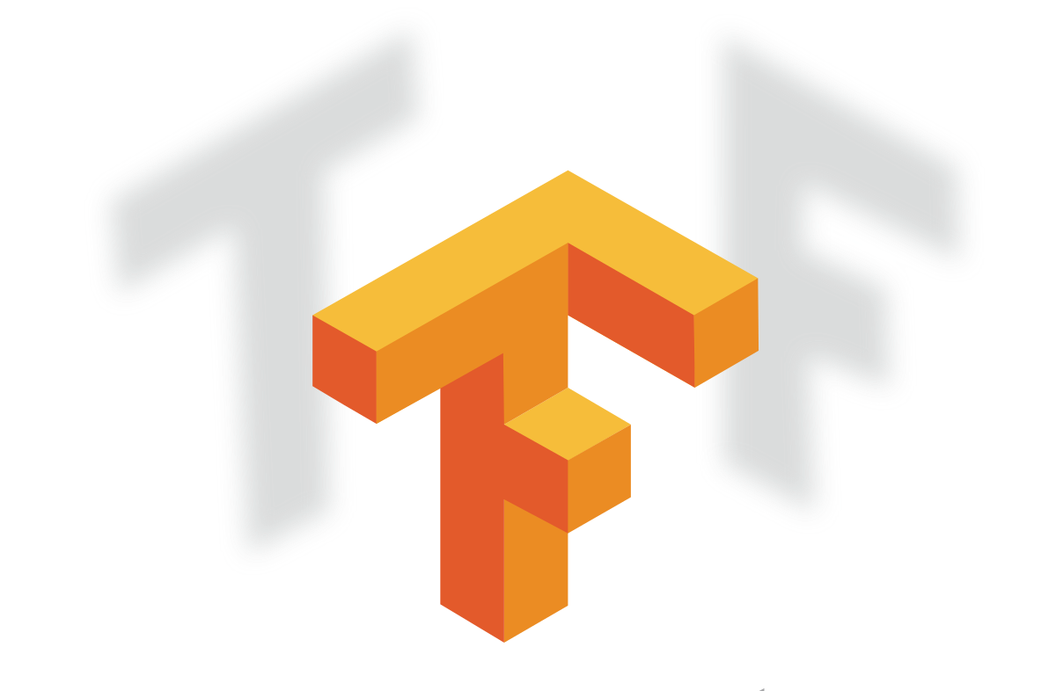
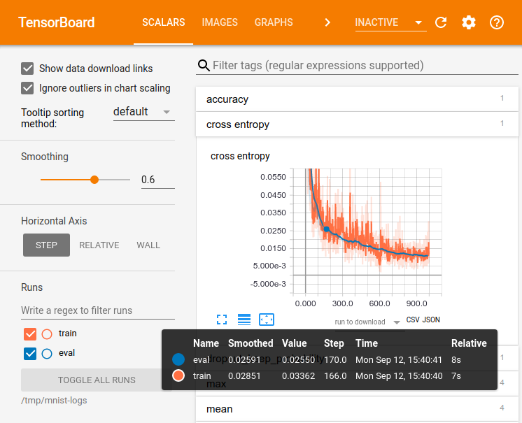
Artificial intelligence Python Library
The most common and most widely used library for machine learning is Tensorflow
Essentially, Tensorflow is first used to train models via a person giving the program some training data (such as files like photos or videos or sounds), then manually selects which part of the file is what the program needs to look for, and then making little dumb robots learn by giving them a test
This is repeated thousands, sometimes millions of times and eventually, the program gets so good at doing that one thing, it may be better than a human
After the training is complete, the program is deployed and can be run on any device
If you are interested in this, ask Fillip about it, he worked with it before - he loves this stuff, he is very excited when he hears about it; it is also the future so building your career in this field is great
Notes:
A good, simple explanation of vectorization: https://stackoverflow.com/a/1422181

Slide 10
Pandas Python package
When we have to work on Tabular data, we prefer the pandas module. | When we have to work on Numerical data, we prefer the numpy module.
The powerful tools of pandas are Data frame and Series. | Whereas the powerful tool of numpy is Arrays.
Pandas consume more memory. | Numpy is memory efficient.
Pandas has a better performance when number of rows is 500K or more. | Numpy has a better performance when number of rows is 50K or less.
Indexing of the pandas series is very slow as compared to numpy arrays. | Indexing of numpy Arrays is very fast.
Pandas offers 2d table object called DataFrame. | Numpy is capable of providing multi-dimensional arrays.
Another package that deals with lots of numbers and data is Pandas
Pandas is built on NumPy (and MatPlotLib), which you have learned about a little before this (and you will learn in a slide or two)
With Pandas you can very easily manipulate data, fill missing data, analyze the existing data, as well as display that data and information to the user
What is the difference between Pandas and the other math modules you might ask?
Well, first of all Pandas is plain prettier, and who doesn't like aesthetic
Personally, Fillip has used it in things like math modeling competitions and more.
Notes:
A good, simple explanation of vectorization: https://stackoverflow.com/a/1422181

Slide 11

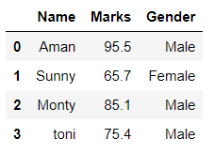
How is pandas pretty?
[[23 46 85]
[43 56 99]
[11 34 55]]
VS
Which one is prettier?

Slide 12
Game dev Python module
Pyglet | Pygame
It is tightly woven with OpenGL. | Pygame uses SDL libraries and does not require OpenGL.
pyglet requires you to subclass to do anything. | pygame is simpler to learn since it doesn’t require you to know-how to create classes or functions
It has 3D support. | It does not have 3D support as it uses the easy python syntax, so the Pygame framework has pretty much everything you need to create a simple 2D game.
Code you wrote for older versions of pyglet will not work without changes. | PyGame is also much more portable, has more people using it, has more developers, and a stable API. So the code you wrote long ago will most likely still work.
Speed wise, pyglet is faster than pygame | pygame is deadly slower than pyglet.
Less community support and less popularity | Since it has been there for a long, there is more community support and has more popularity.
It has been updated | It has not been updated for long time
If you are looking for a career in GameDev or just want to make the next Valorant/Roblox and want to do that in Python(bad idea), you can use PyGame!
PyGame is an open source module that is designed to specifically aid in the development of games
PyGame has access to things like computer graphics and sound libraries that are essential to making a game
Another alternative to PyGame that you can look into is Pyglet, there are a couple differences between them but essentially, they do the same thing which is help the programmer make games
If you want to learn more about any of these things, we recommend you look up what they can do and tutorials on them, neither Fillip nor Arnav have used these modules mainly because we do not make/play games (except for Valorant)

Slide 13
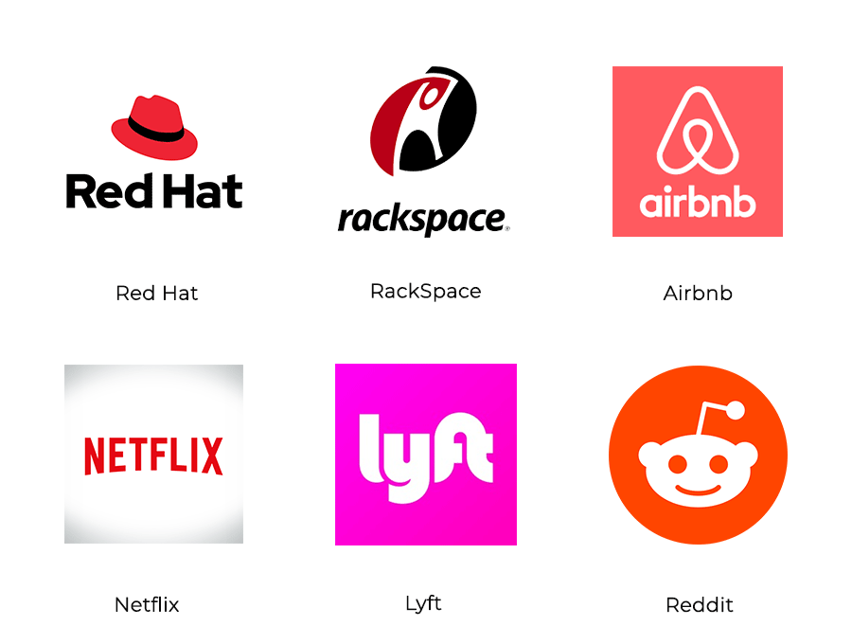
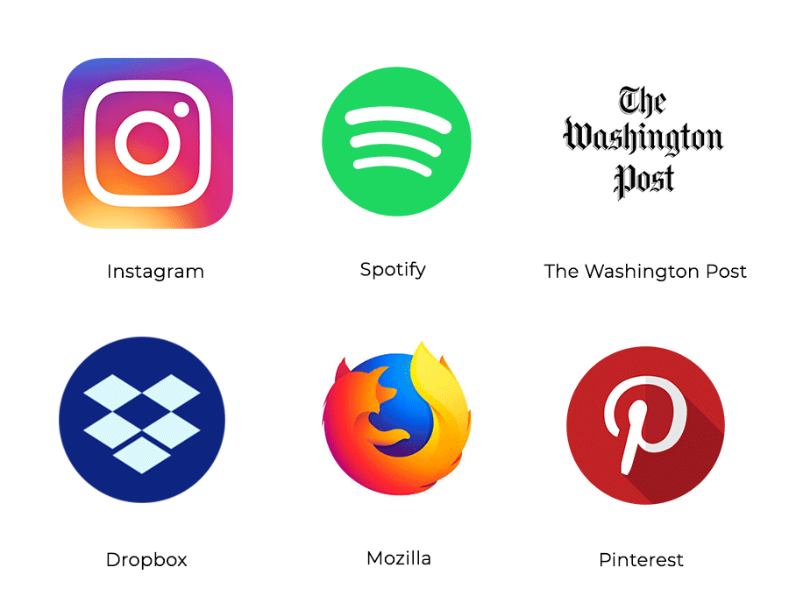
web dev Python module
Websites built with Flask:
If you for some reason want to code web applications in Python, you can use things like Flask or Django
Looking at Flask, you can use it to write web applications and it is built on 3 templates - WSGI, Jinja2 and Toolkit
Django does the same thing as Flask - make web applications
Both of these modules provide packages to effectively code web applications without the need to code the low level stuff that is very annoying, taking that hassle away and leaving you with an easier time
The difference between the two is that because Flask doesn't have that much base code to implement, it is easier to learn, but they both have their own pros and cons - Django might have things that Flask just doesn’t - it all depends on your use case
Websites built with Django:

Slide 14
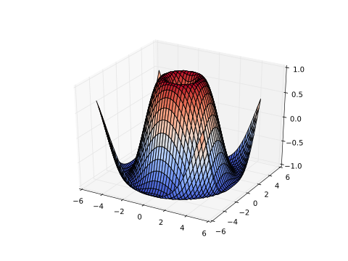
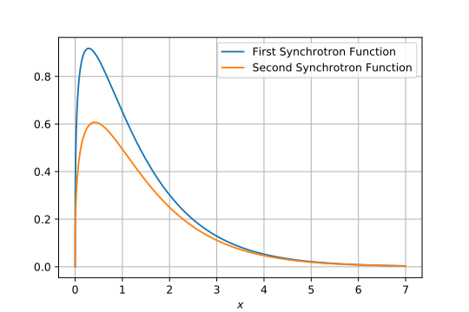
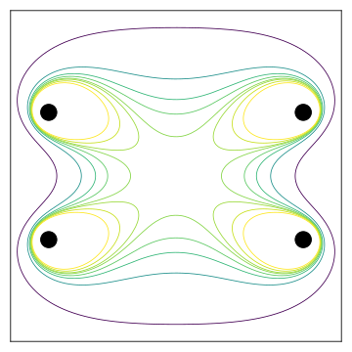
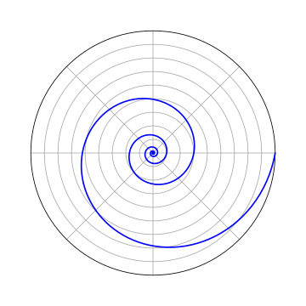
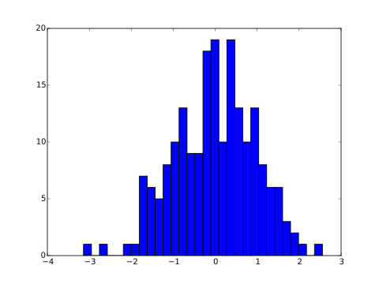
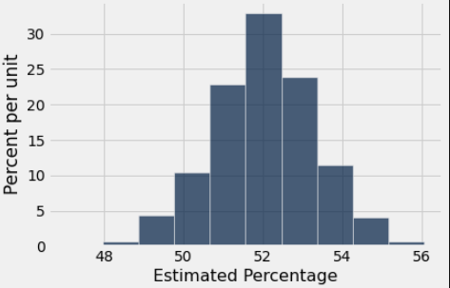
Matplotlib Python module
If you want to visualize data, MatPlotLib is a great place to visit
Given data, MatPlotLib can visualize it via charts, graphs, and more
It is most commonly used with NumPy just because they synergize very well and they are almost always used together just because that's what people need
Also things like Pandas is built on MatPlotLib
It can visualize almost anything (look at graphs to the right)

Slide 15
Just a quick practice to get some hands-on with a library we didn’t go over, random!
Finally...
Practice with Libraries

Slide 16
Problem Set One
Exercise One:
Create a program that takes in activities as a parameter
It doesn’t have to be a list of activities per say, it can really be whatever you want (activities will be what the solution uses)
Use the random module, generate a random 0-10 as a rating for each activity
Then print out the name of the activity with the rating and some phrase dependent on the rating
For example, for my program, ratings 4-7 has the following template: “Man! {activity} is alright! I rate it a {rating} out of 10!"
Confused? You should be because we didn’t go over random, which means it is a lovely opportunity to get some hands on experience with the random documentation
There will be multiple ways to do this, so pick the way that you think is best!
If you’re having trouble, the solution uses a list and the randint method

Slide 17
We will be back to Projects and new material next week!
Thank you!
That is all we have for today!

